Slide 1

WELCOME

Slide 2


AGENDA
What is Lifestyle Medicine Solutions?
Program Curriculum
Program Schedule
Program Resources
Program Costing

Slide 3
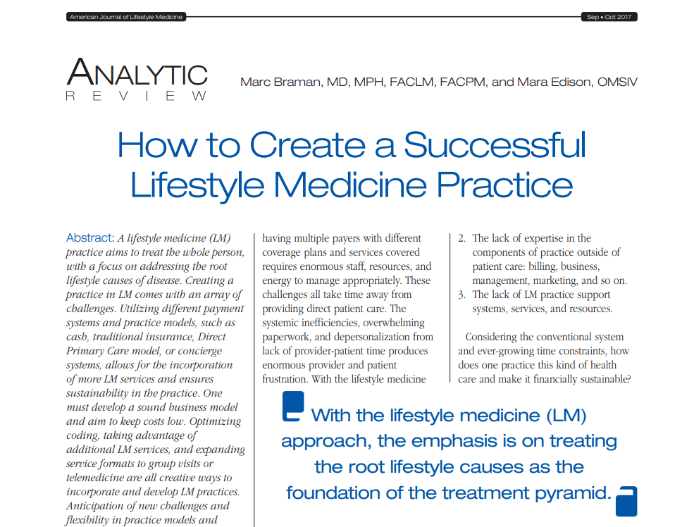

Slide 4
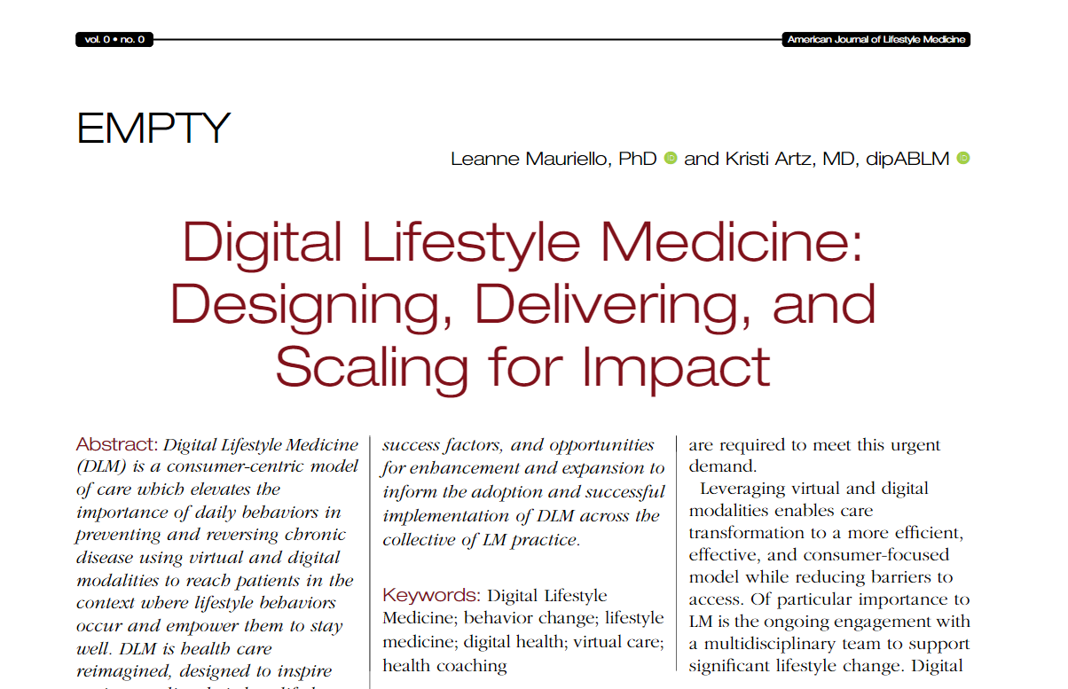

Slide 5
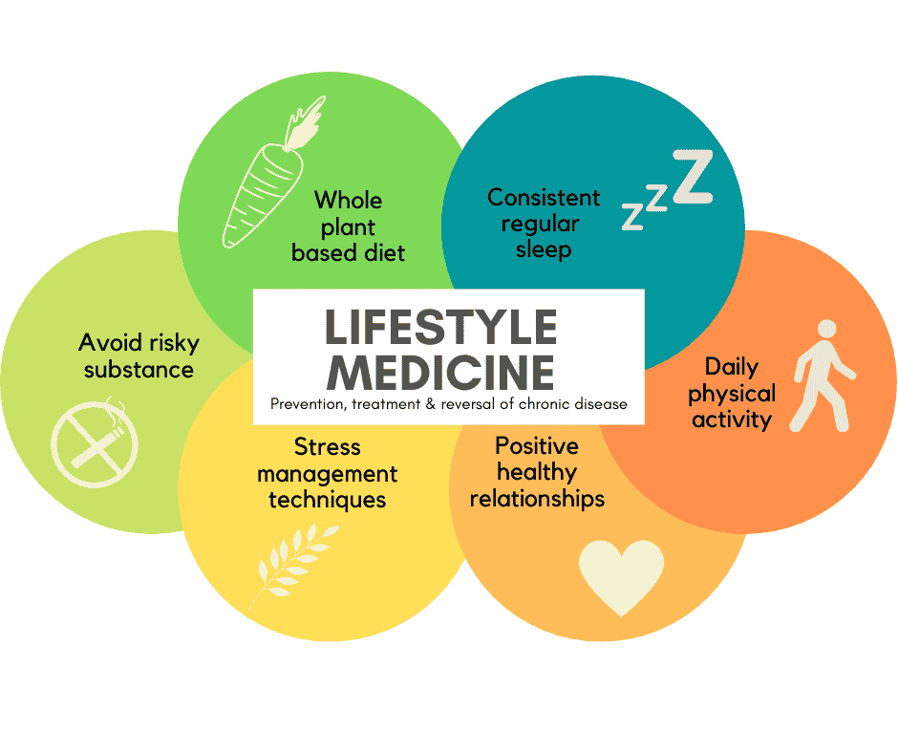
Implementation of DLM Practice
Launching DLM specialty practice during COVID provided an opportunity to build a virtual first approach.
  provider consults
  shared medical appointments (SMAs)
  Medical nutrition therapy (MNT)
  Tobacco and nicotine consultation
  health coaching
  webinars
  remote culinary medicine classes

Slide 6

What is
Lifestyle Medicine
Solutions?
Lifestyle Medicine Solutions is a provider of comprehensive program that emphasize the 6 key interventions of lifestyle medicine to change lives, promote optimal health and cut health care costs.

Slide 7

SIX
KEY PILLARS OF
LIFESTYLE MEDICINE
Plant-based eating pattern
Physical activity
Sleep and rest
Stress management
Avoiding risky substances
Social connections

Slide 8
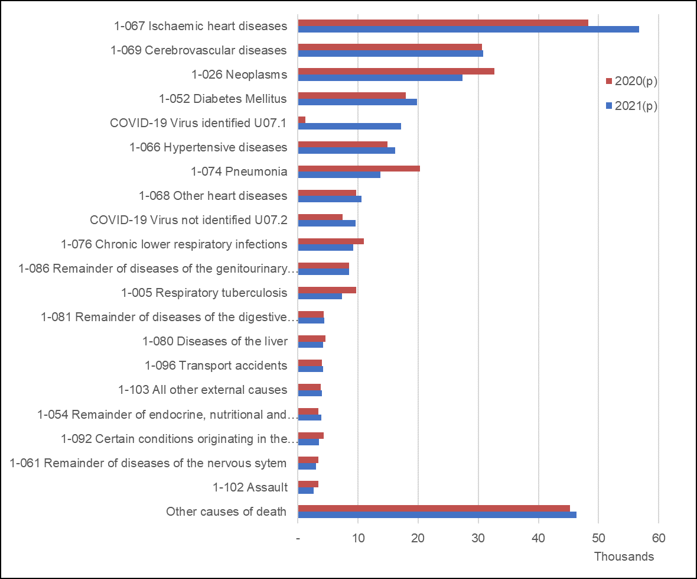
THE IMPACT OF LIFESTYLE CHOICES
Most of the top causes of death in the country are lifestyle-related
It is estimated that 70% of chronic disease is caused by behavioral factors that are highly modifiable
Philippine Statistics Authority Data
World Health Organization Data

Slide 9
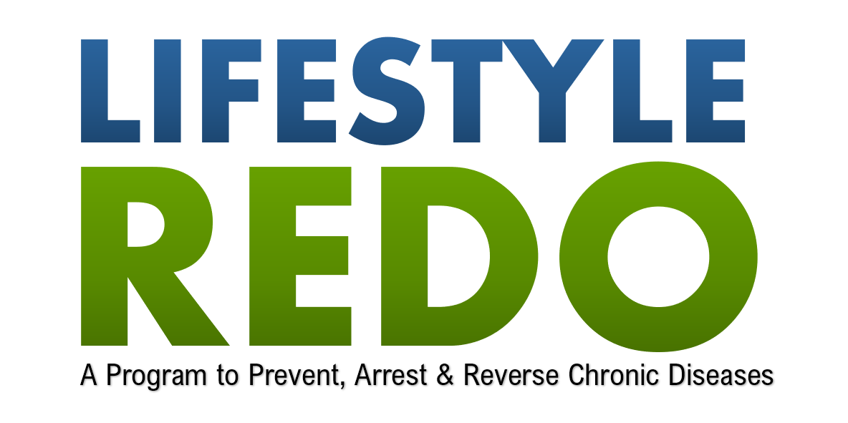

Slide 10

PROGRAM
CURRICULUM

Slide 11
WHAT IS Lifestyle REDO?
Founded in 2008 as healthy lifestyle program.
Utilized in clinical, corporate, and community settings.
Conducted in over 120 venues with over 6,000 participants from different People’s Organizations, including women, out-of-school-youth, farmers, armed officials, and indigenous people.
Live-in Lifestyle Program was first offered in 2013 (7-28 weeks intervention)
Digital Lifestyle Medicine platform was developed in 2018 under the management of the Lifestyle Medicine Solutions Inc.

Slide 12
HOW IT WORKS?
Shared medical appointments are facilitated by certified and accredited lifestyle medicine physicians, professionals, and coaches.
An interface that serves as a hub that guides participants through the program
Core pillar video content to teach participants how to apply lifestyle medicine to build lasting healthy habits
Program workbook and Journal to track progress and reflect on the journey toward optimal health
Culinary medicine module and online meal planner with over 100 healthy, nutritious recipes
Educational materials such as articles, and “explainer” videos on topics related to behavior changes and lifestyle medicine
  Explainer and intervention program modules focusing on chronic diseases
  Articles and fact sheets

Slide 13
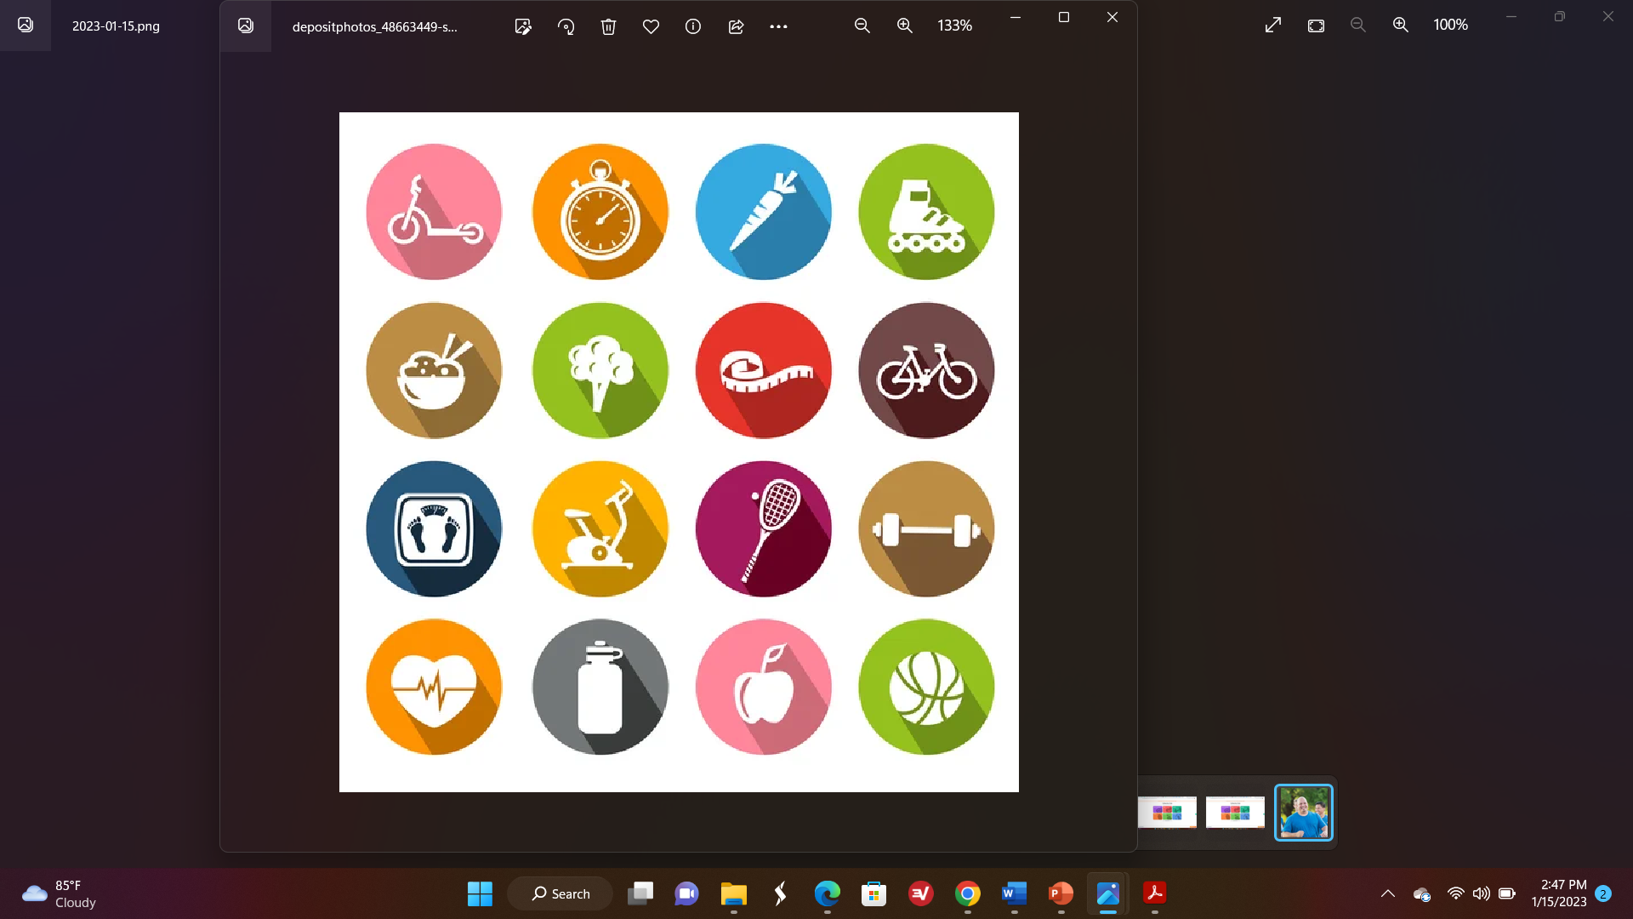
12-WEEK PROGRAM OVERVIEW
WEEK 1
Lifestyle is Medicine
* Preparation
WEEK 2
Culinary Medicine
* Transition Phase
WEEK 3
Exercise is Medicine
* Jumpstart Phase
WEEK 4
Breaking Barriers
* Jumpstart Phase
WEEK 5
Sleep Health & Rest
* Intensive Phase
WEEK 6
Plant-based Power
* Intensive Phase
WEEK 7
Achieving Optimal Weight
* Intensive Phase
WEEK 8
Staying on Track
* Intensive Phase
WEEK 9
Mindfulness
* Maintenance
WEEK 10
Social Connections & Self-care
* Maintenance
WEEK 11
The Optimal Lifestyle
* Maintenance
WEEK 12
Going for Autopilot
* Maintenance

Slide 14

PROGRAM
DELIVERY

Slide 15
12-WEEK PROGRAM SCHEDULE
Week 1
Week 2
Week 3
Week 4
Week 5
Week 6
Week 7
Week 8
Week 9
Week 10
Week 11
Week 12
WEEKLY SESSION 11
COACHING SESSION 5
WEEKLY SESSION 9
WEEKLY SESSION 12
COACHING SESSION 3
COACHING SESSION 6
WEEKLY SESSION 10
COACHING SESSION 2
WEEKLY SESSION 4
WEEKLY SESSION 8
COACHING SESSION 4
WEEKLY SESSION 5
WEEKLY SESSION 6
COACHING SESSION 1
WEEKLY SESSION 7
WEEKLY SESSION 2
ON-BOARDING
WEEKLY SESSION 3
WEEKLY SESSION 1
Baseline Labs
Lifestyle Assessment
Post-Intervention Labs
Lifestyle Assessment

Slide 16
12-MONTH PROGRAM SCHEDULE
4th Mo
5th Mo
6th Mo
7th Mo
8th Mo
9th Mo
10th Mo
12th Mo
GROUP SESSION 5
GROUP SESSION 7
WEEKLY SESSION 11
GROUP SESSION 3
GROUP SESSION 6
GROUP SESSION 8
GROUP SESSION 2
MONTHLY SESSION 4
MONTHLY SESSION 8
GROUP SESSION 4
MONTHLY SESSION 5
GROUP SESSION 1
MONTHLY SESSION 6
EVERY 2 WEEKS SESSION 2
MONTHLY SESSION 7
EVERY 2 WEEKS SESSION 1
EVERY 2 WEEKS SESSION 3
OUTGOING
Monthly Lifestyle Assessment
Remote Monitoring
Annual Labs
Lifestyle Assessment

Slide 17

LIFESTYLE REDO MODULES
Once a week Session
Treatment Phase (1st 12 weeks)
Lifestyle is Medicine
Culinary Medicine
Exercise is Medicine
Breaking Barriers
Sleep Health and Rest
Plant-based Power
Achieving Optimal Weight
Staying on Track
Mindfulness
The Optimal Lifestyle
Going Autopilot

Slide 18
LIFESTYLE REDO MODULES
Monitoring Phase (2nd 12 weeks)
Being Active – Your Own Way
The Slippery Track of Lifestyle Change
Take Charge of What You Can Control
Keys to Healthy Eating Out
Staying Motivated
Problem Solving

Slide 19
LIFESTYLE REDO MODULES
Support Phase (1st 12 weeks)
Moving on Top pf Physical Activity
Mastering What’s on Your Plate
Stress and Time Management – Staying on Track
A Closer Look at Your Health Journey
Intercepting Lapses and Relapse
Looking Back and Moving Forward
Culmination

Slide 20
LIFESTYLE REDO WORKBOOK
Participants will receive their program workbook, jumpstart kit and cookbook.

Slide 21
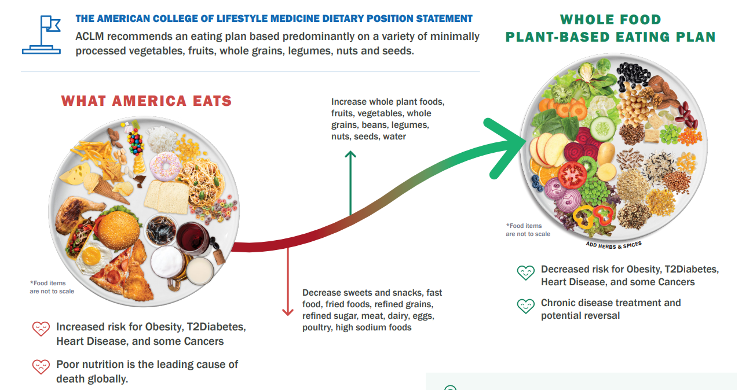
DIET RECOMMENDATIONS
Lifestyle REDO is not a VEGAN Program

Slide 22

PROGRAM
RESOURCES

Slide 23
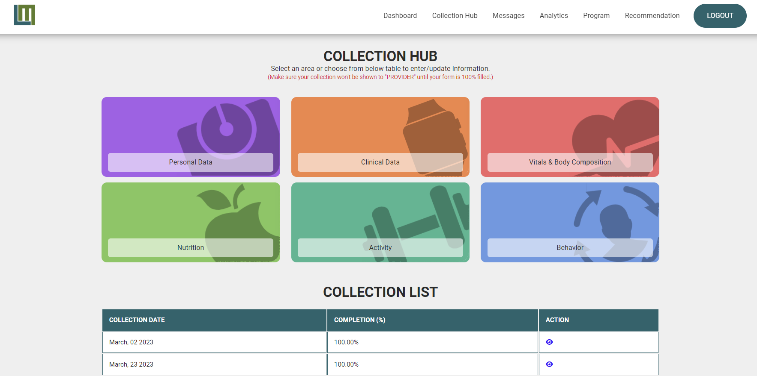

Slide 24

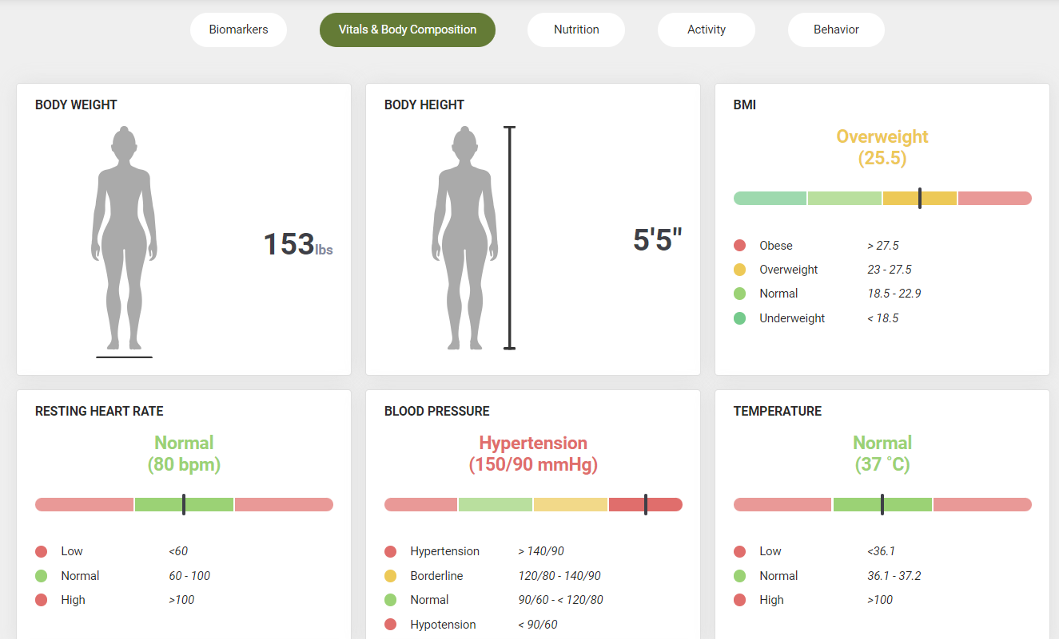
TRACKING PROGRESS
Participants track progress with lifestyle assessments and blood tests through the Lifestyle Medicine Solutions Interface

Slide 25
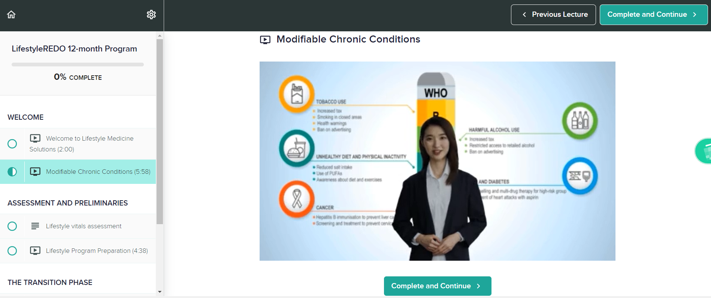
LIFESTYLE REDO PROGRAM

Slide 26
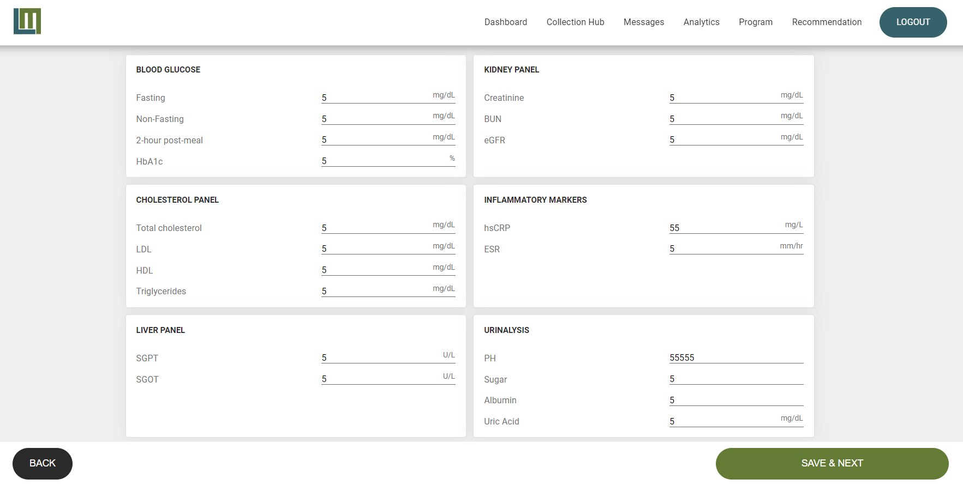

Slide 27
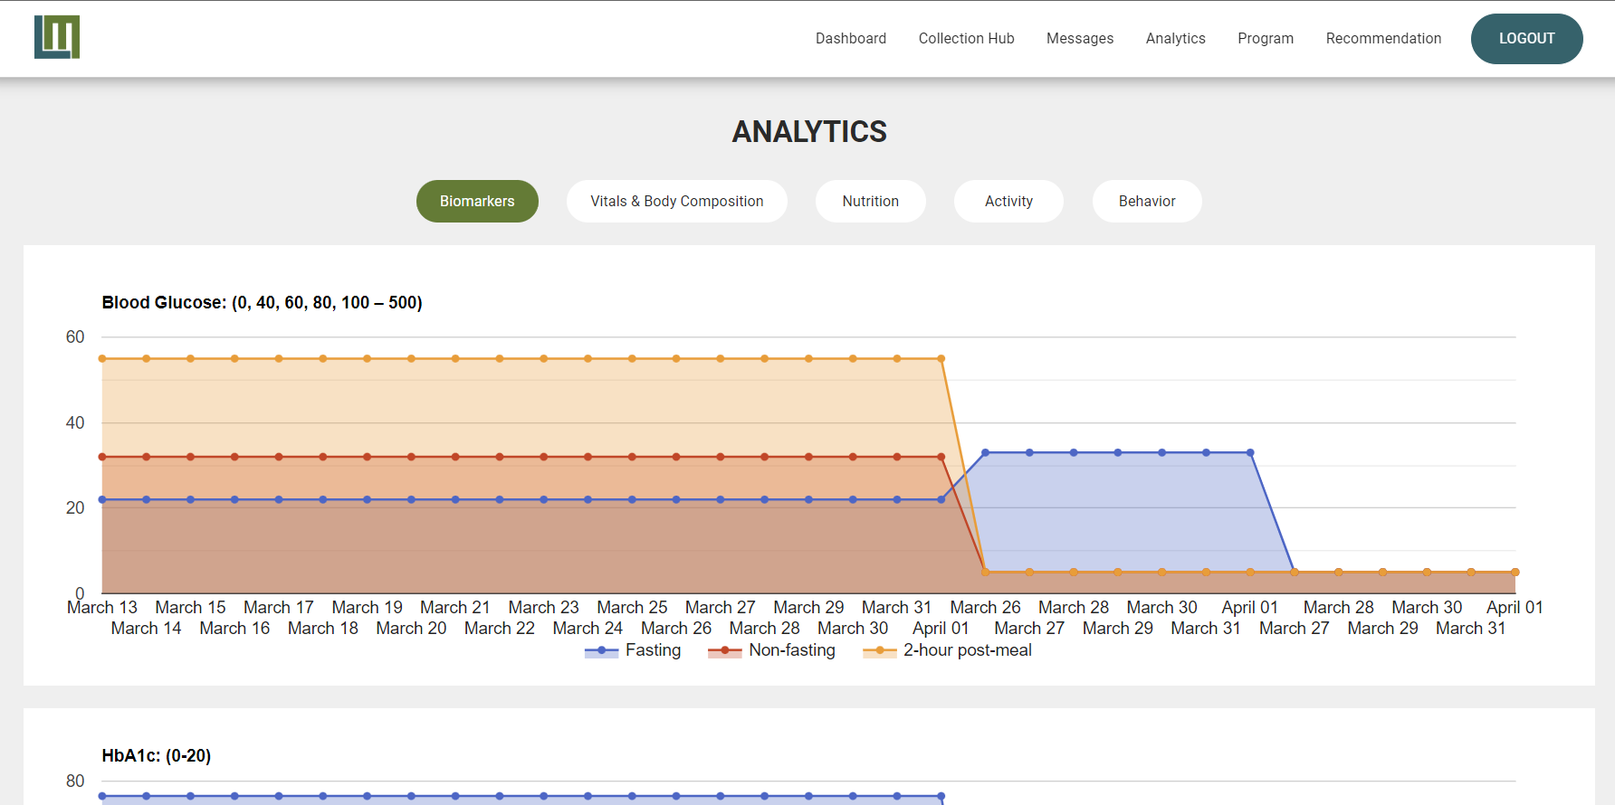

Slide 28
PROGRAM
BENEFITS

Slide 29
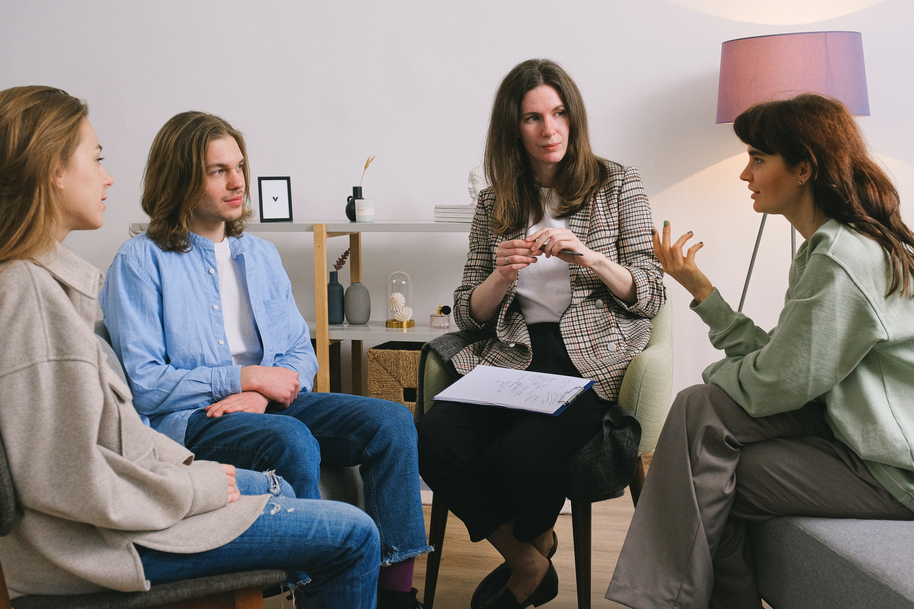
GROUP SUPPORT SESSIONS
Exploring behavior change strategies and cultivating motivation and support system

Slide 30

GROUP SUPPORT SESSIONS
Change Lives
Improve Health Outcome
Improve Quality of Life
Cut Health care Cost

Slide 32
LIFESTYLE REDO COSTING
PROGRAM | PROGRAM COST
12-Week | P500.00/month
4th – 12th month | P150.00/month
OTHER COST
  Workbook – P650/patient
  Cooking sessions

Slide 33
ONBOARDING SCHEDULE
BATCH | DATE | PAX
1 | 01-29-23 | 30
2 | 02-26-23 | 30
3 | 03-26-23 | 30
4 | 04-30-23 | 30
PCLM Diplomates
PCLM Trainees
  Fellows/Diplomates/Allied Health/Health Coaches
  General Practitioners

Slide 34


Slide 35
THANK YOU

