Slide 1
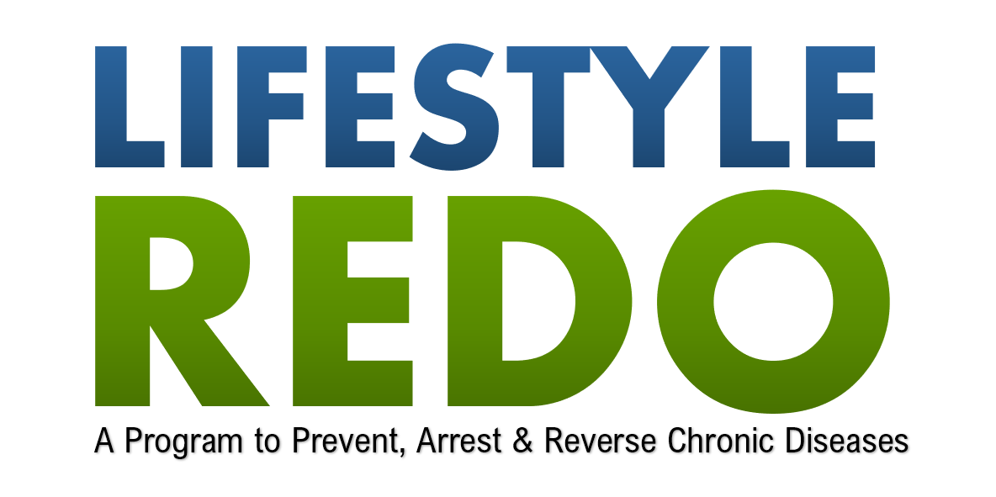

SESSION 4 – What is Culinary Medicine?

Slide 2
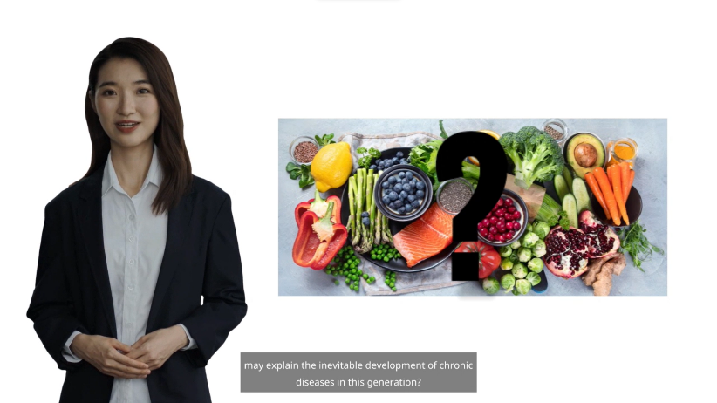
Notes:
Ask the participants to share what they think is the difference between the food that people eat before and now that contributes to the increasing number of chronic diseases.
People eat fruits, vegetables, meat, poultry, and fish. What could be the difference?
(look for the answers on food processing).

Slide 3

What is Culinary Medicine?
Culinary Medicine is the art of cooking for health. As defined by the American College of Preventive Medicine, it is the practice of helping patients use nutrition and good cooking habits to restore and maintain health. It's a new field that combines important scientific principles related to nutrition, behavior, and Medicine. Culinary Medicine offers a simple approach to understanding how food and cooking relate to personal health, habits, and healthcare goals. It is a crucial self-care tool studied by medical professionals and implemented at the practitioner level to better counsel patients and improve health outcomes.

Slide 4

The Choice is Yours
One hundred years ago, very few people suffered from coronary heart disease, stroke, diabetes, and cancer. These lifestyle-related illnesses were relatively rare and accounted for a small percentage of deaths worldwide. However, fast forward to today, and these diseases have become rampant, claiming the lives of millions of people every year. The alarming rise of these illnesses is directly linked to our modern lifestyle choices.

Slide 5
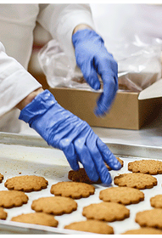
Food Processing
With the advent of processed foods, sedentary lifestyles, and increasing levels of stress, our bodies are under constant strain. Our diets are high in saturated fats, refined sugars, and processed carbohydrates, all of which contribute to the development of chronic diseases. Additionally, our increasingly fast-paced lives leave little time for rest, relaxation, and taking care of our health. It's no wonder that these lifestyle-related illnesses have become the leading causes of death worldwide.

Slide 6

Disease from food? Do you mean pesticides and preservatives?
Surprisingly, pesticides and preservatives aren’t the worst offenders. Here are some of the more serious culprits:
Sugar
Refined Foods
Salt
Fat
Protein
Beverages
Snacks
Notes:
Sugar. The National Research Council reports that refined sugars and sweeteners account for up to 20 percent of many people’s daily calories. Devoid of fiber and nutrients, refined sugars are empty, or naked, calories. But because of their caloric density, they are well suited to promote obesity.
Refined foods. People used to think refinement was good because it got rid of useless roughage. Now we’re learning how necessary fiber is in protecting us from certain cancers, stabilizing blood sugar, controlling weight, and preventing gastrointestinal problems such as gallstones, hemorrhoids, diverticulitis, and constipation.
Salt. Most people consume 10 to 20 grams (two to four teaspoons) of salt a day. This is many times more than is actually needed and contributes prominently to high blood pressure, heart failure, and kidney disease.
Fat. Most people don’t realize that they are consuming an average of 37 percent of their calories as fat. This is much more than the body can properly handle. As a result, blood vessels plug up, impotence sets in, and hearts and brains suffer. A high-fat diet also contributes to overweight, adult diabetes, and certain cancers.
Protein. A diet heavy in meat and animal products provides more protein, fat, and cholesterol than the body can use. People eat two or three times more protein than is recommended. Scientists now recognize that a diet containing less protein and much less fat and cholesterol is essential for improved health and longevity.
Beverages. In a modern diet, people are consuming less and less water. Instead, they average several servings of soda pop, beer, coffee, milk tea, and sweet drinks every day. Because most of these drinks are loaded with calories from sugar and alcohol, they can play havoc with blood sugar levels and sabotage weight-control efforts. Caffeine, phosphates, and other chemicals found in beverages pose additional health risks.
Snacks. Engineered taste sensations are taking the place of real food. Schools, daycare centers, and even hospitals require snacks to reign supreme after school and at home. Well-planned family meals are now the exception. Snack attacks disrupt digestion, overburden the stomach, and are a frequent cause of bloating and indigestion.

Slide 7
We have the power to change our destiny
By adopting a better diet and wiser lifestyle habits, we can significantly reduce our risk of developing these chronic diseases.
Switching to a whole-foods-based diet, rich in fruits, vegetables, whole grains, and lean proteins, can provide the essential nutrients needed to fight disease and promote longevity.

Slide 8
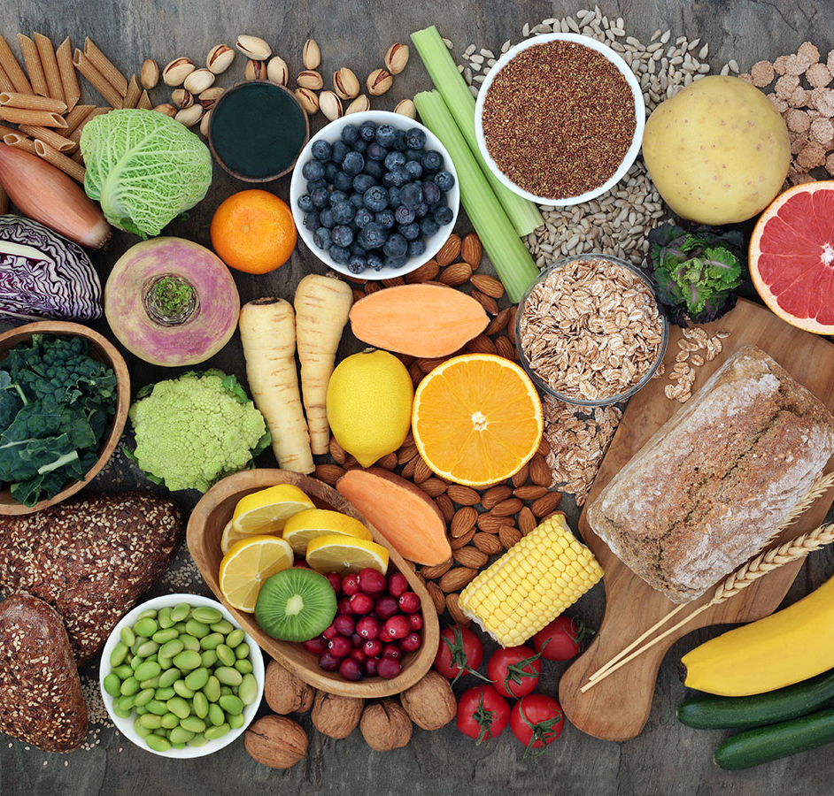
Is there anything safe to eat?
Fruit
Vegetables
Legumes
Nuts and Seeds
Whole grains
Notes:
When it comes to eating a healthy diet, incorporating a variety of fruits is essential. Think of fruit: hundreds of varieties, spectacular colors, and every imaginable texture and flavor. From juicy watermelons to tangy pineapples, there is a fruit to suit every taste preference. Not only are fruits delicious, but they are also packed with essential vitamins, minerals, and antioxidants that promote good health. Whether you prefer to eat them fresh, blend them into smoothies, or use them in baking, fruits provide a natural and nutritious way to satisfy your sweet tooth.
While fruits are a vital component of a healthy diet, vegetables, potatoes, and root crops should not be overlooked. These nutrient-dense foods are rich in fiber, vitamins, and minerals, making them a valuable addition to any meal. From crunchy carrots to leafy greens, the array of vegetables available offers endless possibilities for creating delicious and nutritious dishes. Incorporate vegetables into your meals in creative ways, such as adding them to stir-fries, roasting them in the oven, or tossing them in salads.
Legumes, including beans, lentils, and chickpeas, are another important food group to include in your diet. Not only are they a great source of plant-based protein, but they also offer a wide range of shapes, colors, and flavors. From creamy white beans to rich black beans, the variety of legumes available ensures you never get bored of eating them. Legumes can be used in soups, stews, salads, and even desserts, making them a versatile ingredient that adds both taste and nutrition to your meals.
Eating a variety of whole-plant foods will provide all the fat, protein, and nutrients the body needs. It’s also ecologically sensitive and will cut the food budget in half.
The best news is that this kind of dietary lifestyle helps delay and often prevent the onset of most killer diseases. Eating full-fiber plant foods not only allows people to eat larger quantities of food without having to worry about weight gain but also can promote optimum health and energy for a lifetime.

Slide 9
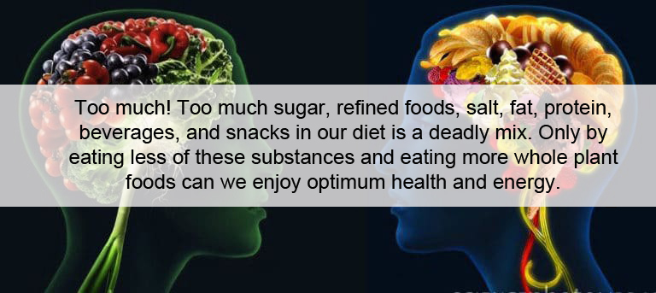

Slide 10
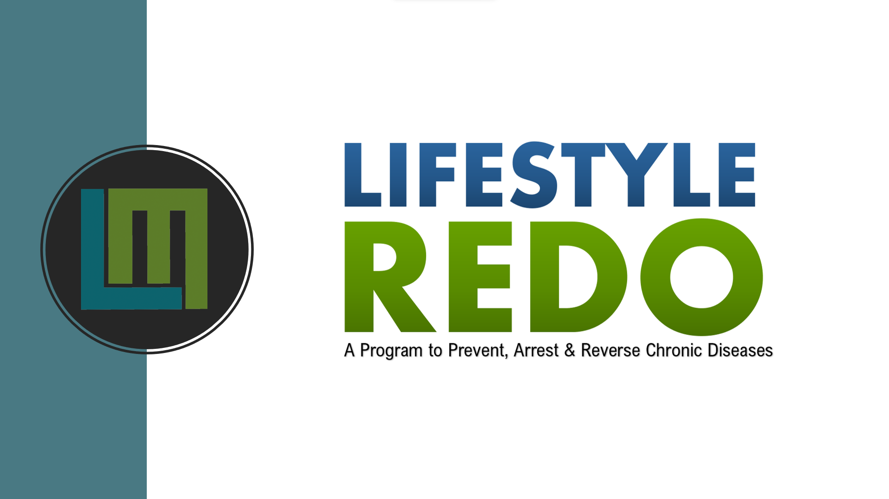
SESSION 4 – Activity

Slide 11
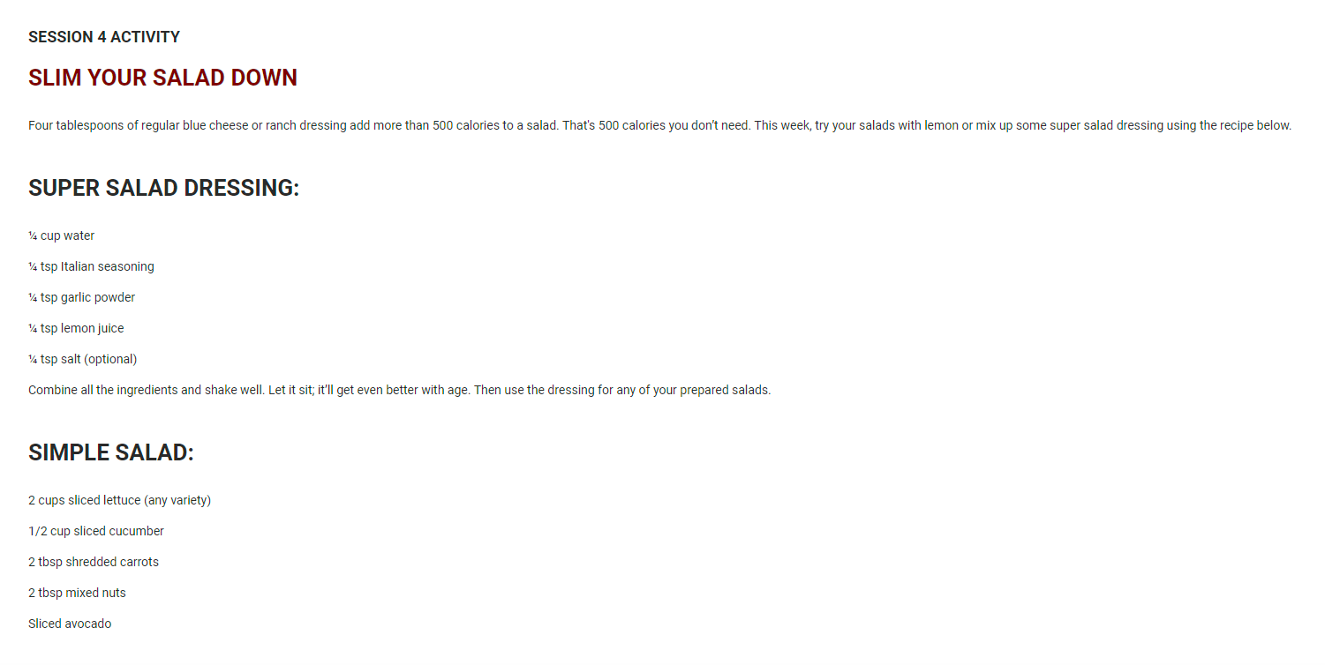
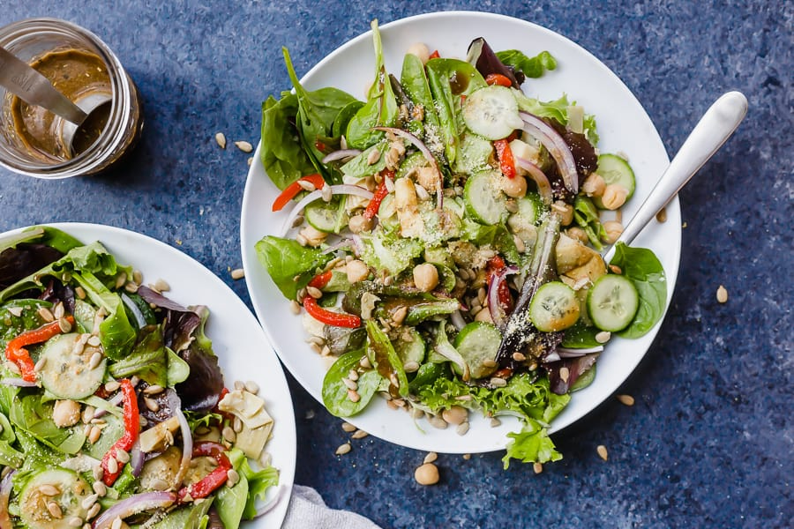

Slide 12
SESSION 5 – The Diet Transition

Slide 13
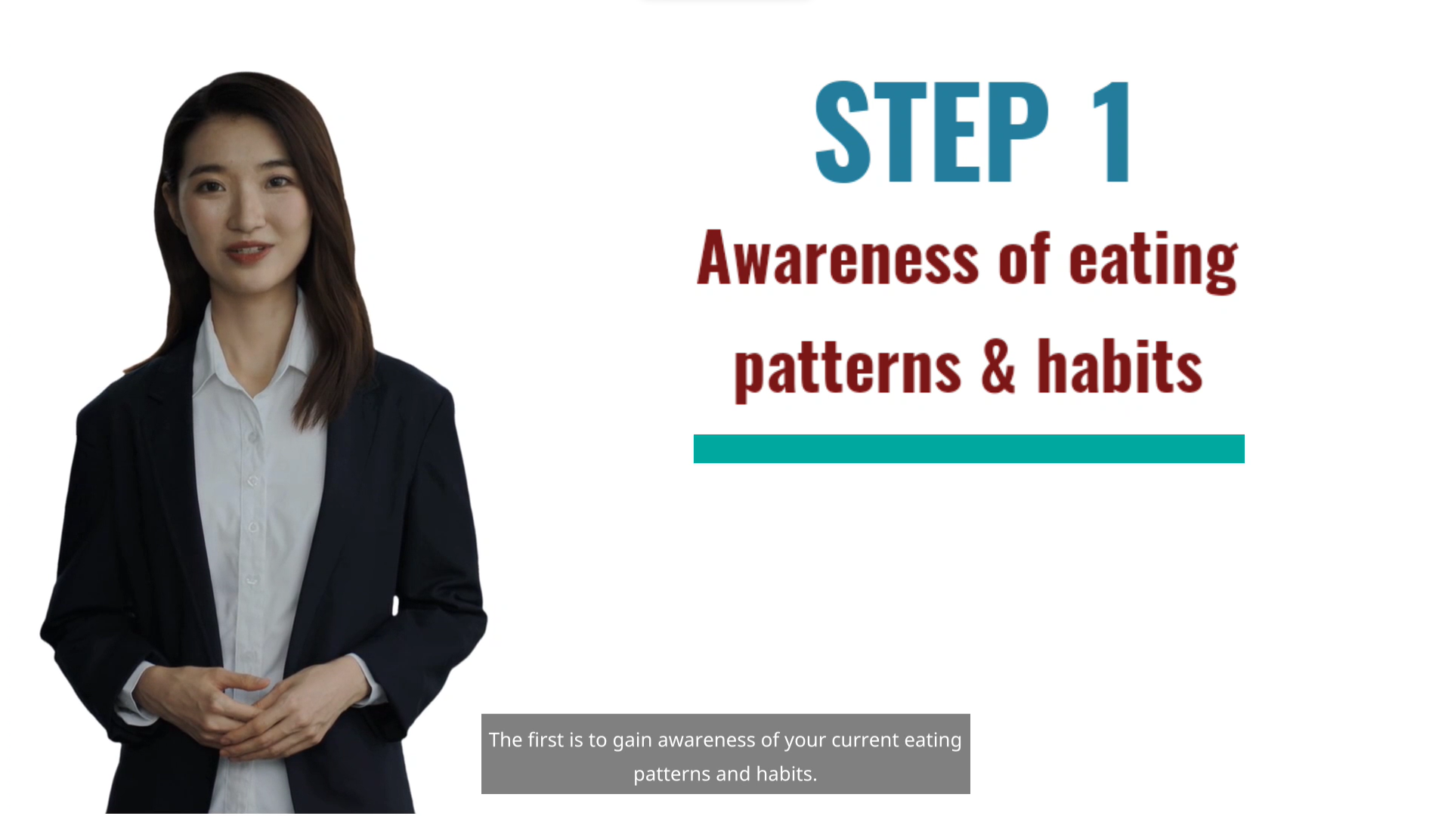

Slide 14
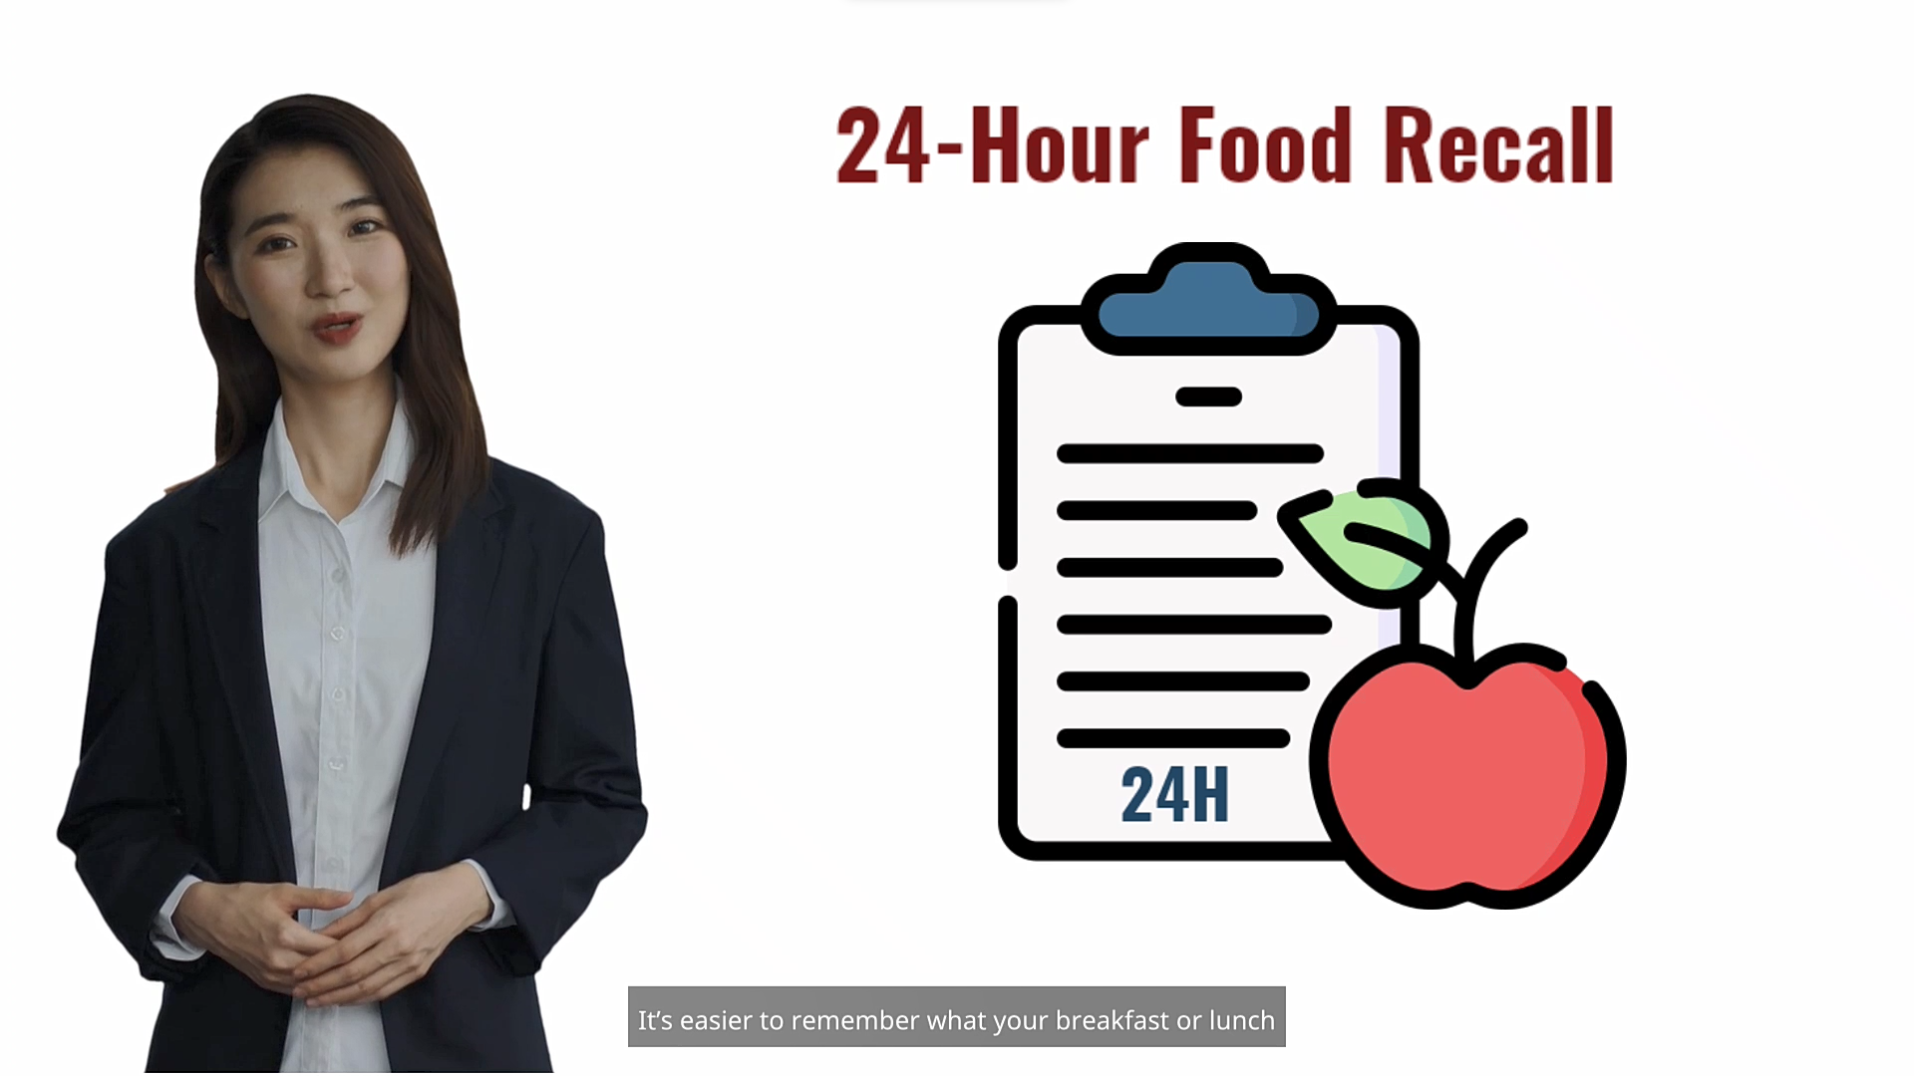
Notes:
Emphasize the importance of having awareness on personal dietary patterns. Practice the 24-hour food recall. It’s easier to remember the food taken in the past 24 hours, and then review which food groups should be taken more or taken less the following day.
Ex: I ate too much fat today so I have to eat less tomorrow.

Slide 15

Notes:
Encourage food journaling to check eating habits that needs to be improved.
Strive to make the healthy choice an easy choice by preparing healthy foods around that should be available when hunger or thirst sets in.
Ex: having a bag of nuts will encourage one to eat a healthier snack.

Slide 16
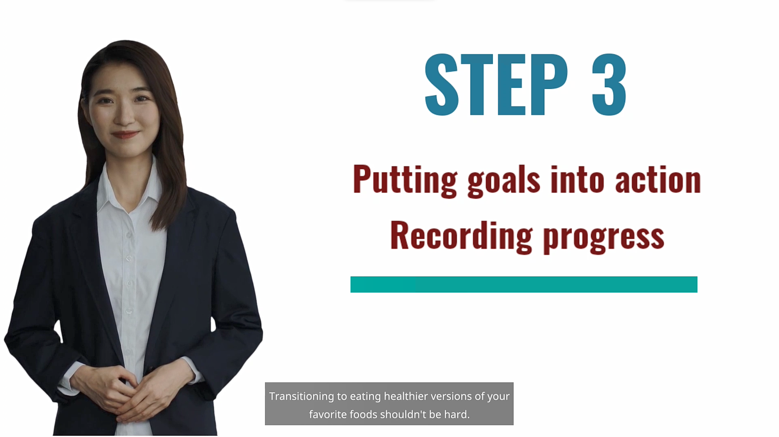
Notes:
Ask any of the participants who’s interested in sharing their goal and how they think they can transition to achieve it.

Slide 17

Notes:
Encourage eating at home. But it’s important to understand that foods prepared at home should be tasteful and palatable.
Review the important factors that affects food preparation: -Taste and Texture

Slide 18
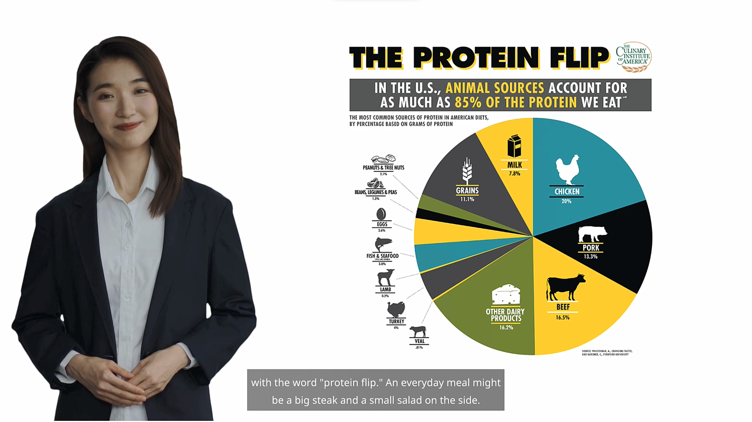
Notes:
Emphasize flipping the plate while on transitioning – Protein Flip and Dessert Flip.
The goal is to let them still enjoy the taste of their favorite dish, but this time they are consuming more healthier ingredients in every food serving.

Slide 19
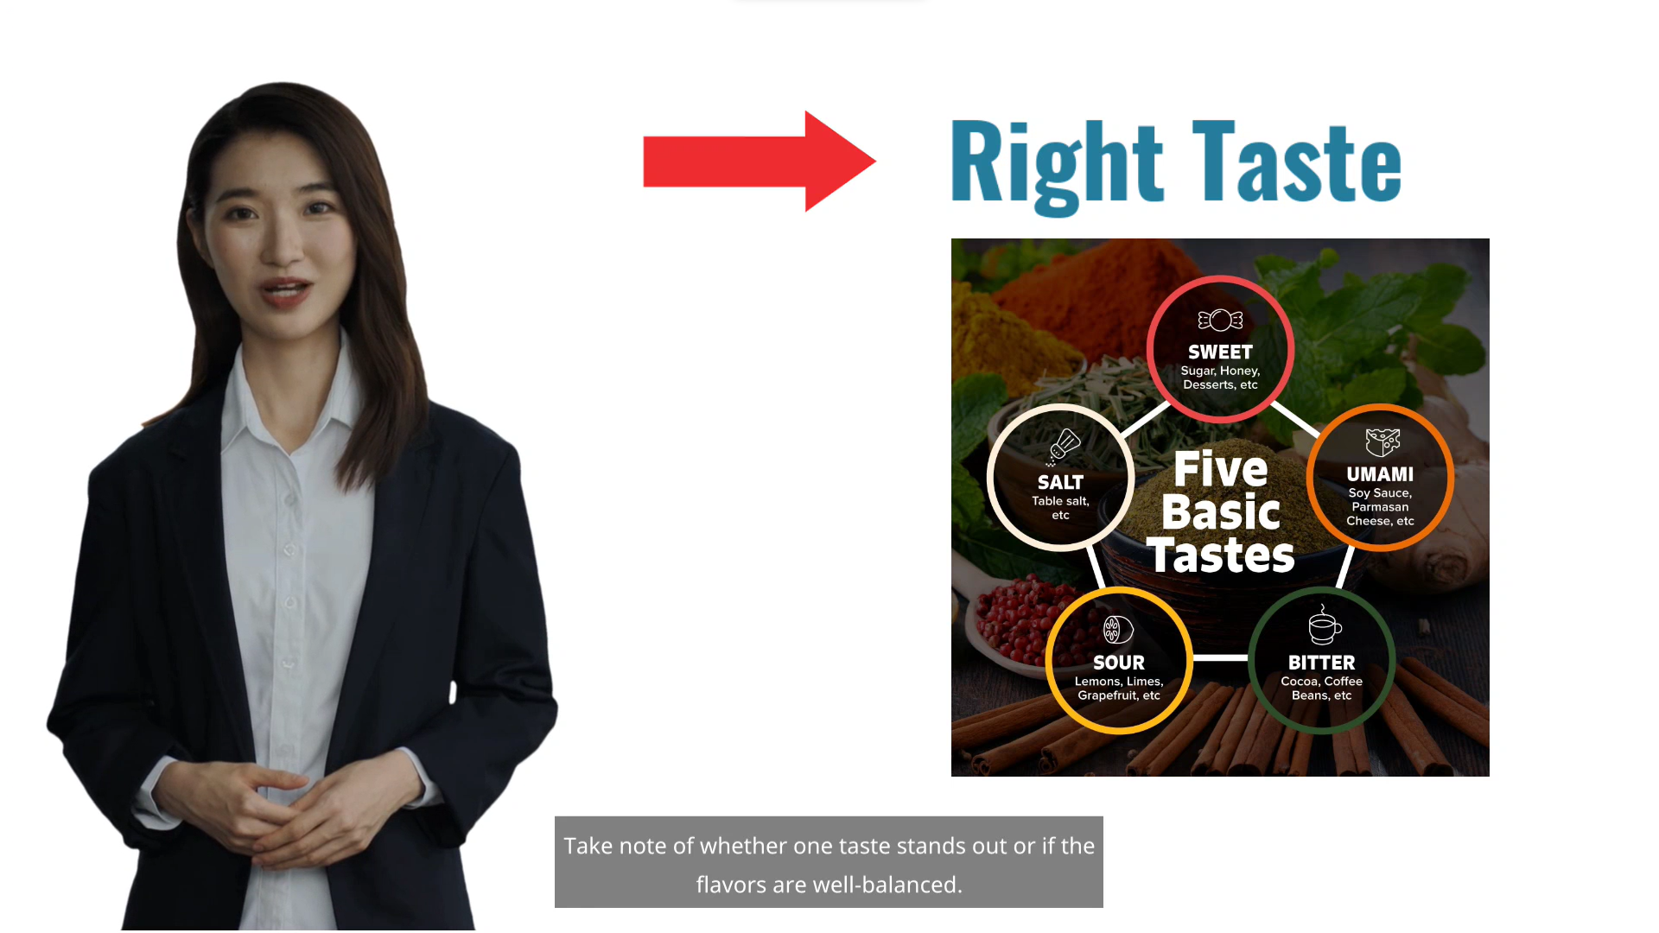

Slide 20
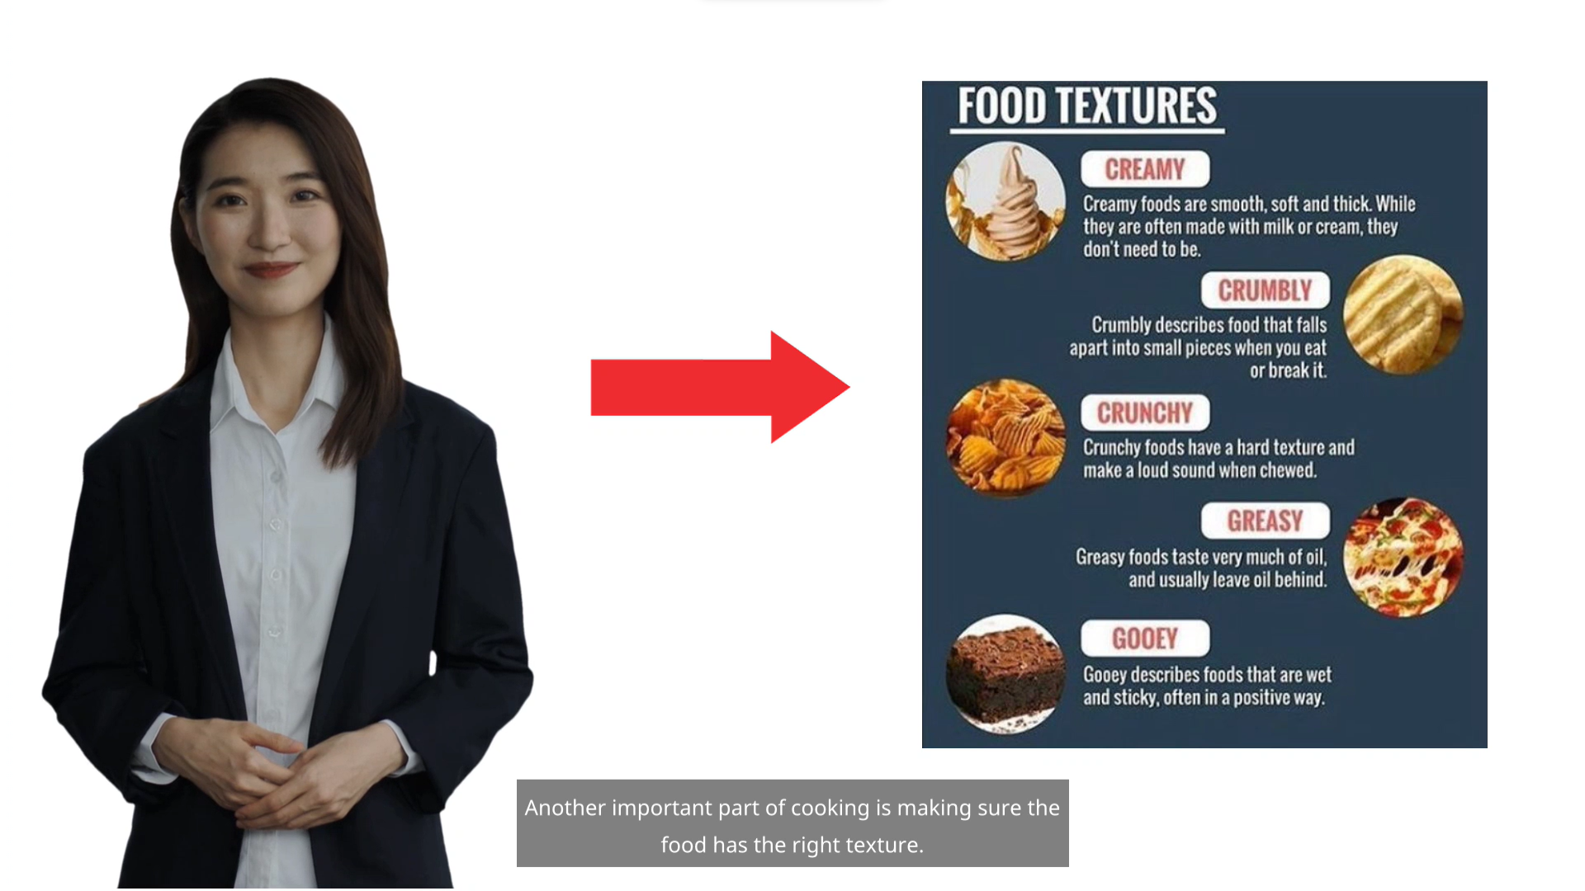

Slide 21
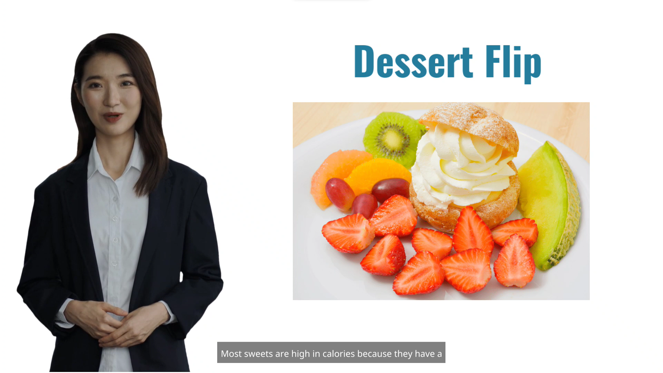

Slide 22
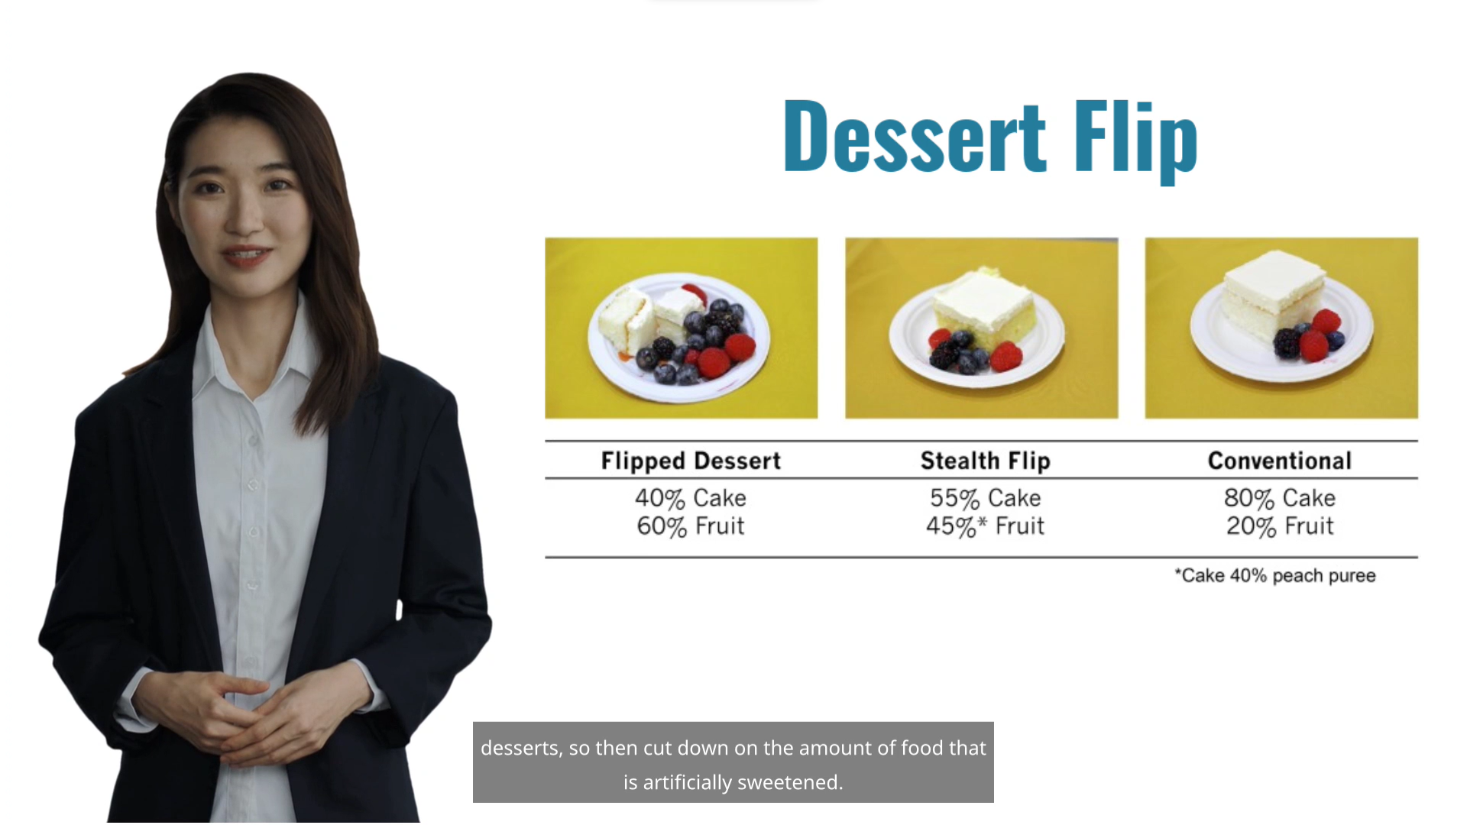

Slide 23
SESSION 5B – Understanding Heart Disease

Slide 24
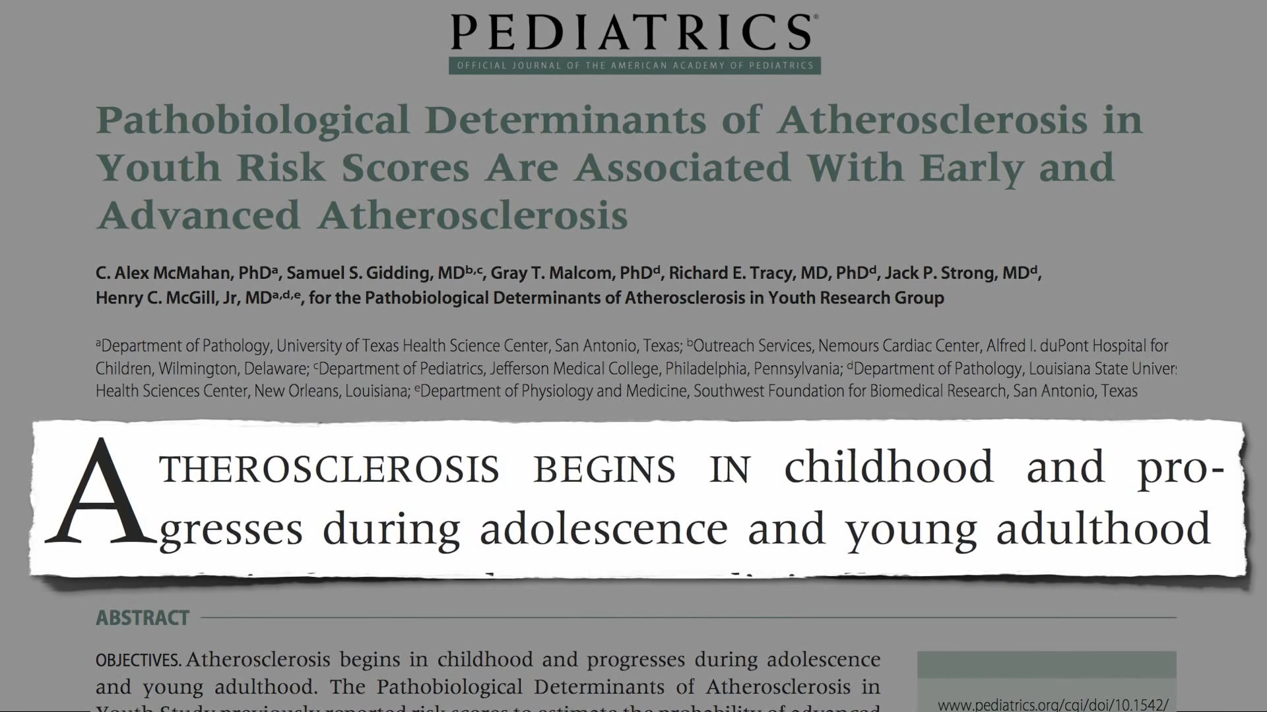

Slide 25
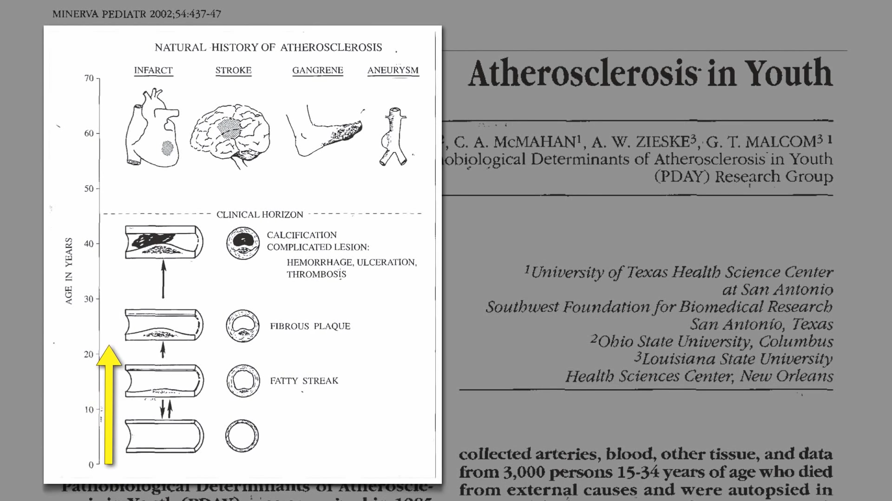

Slide 26
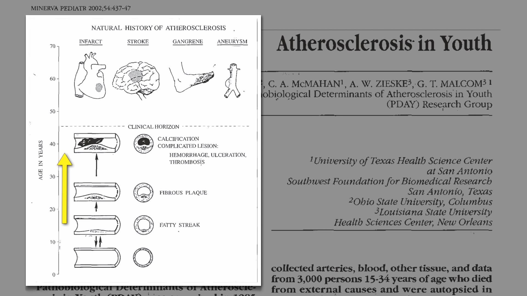

Slide 27
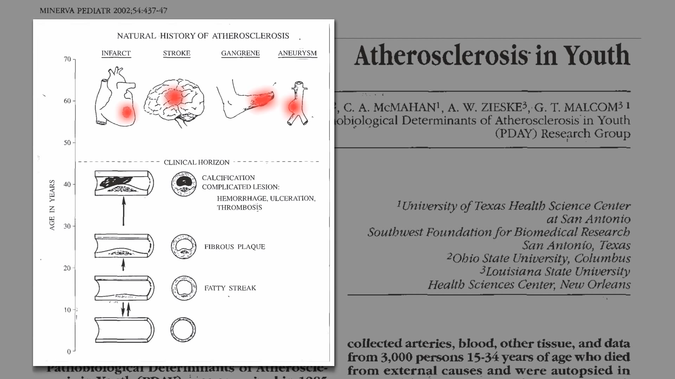

Slide 28
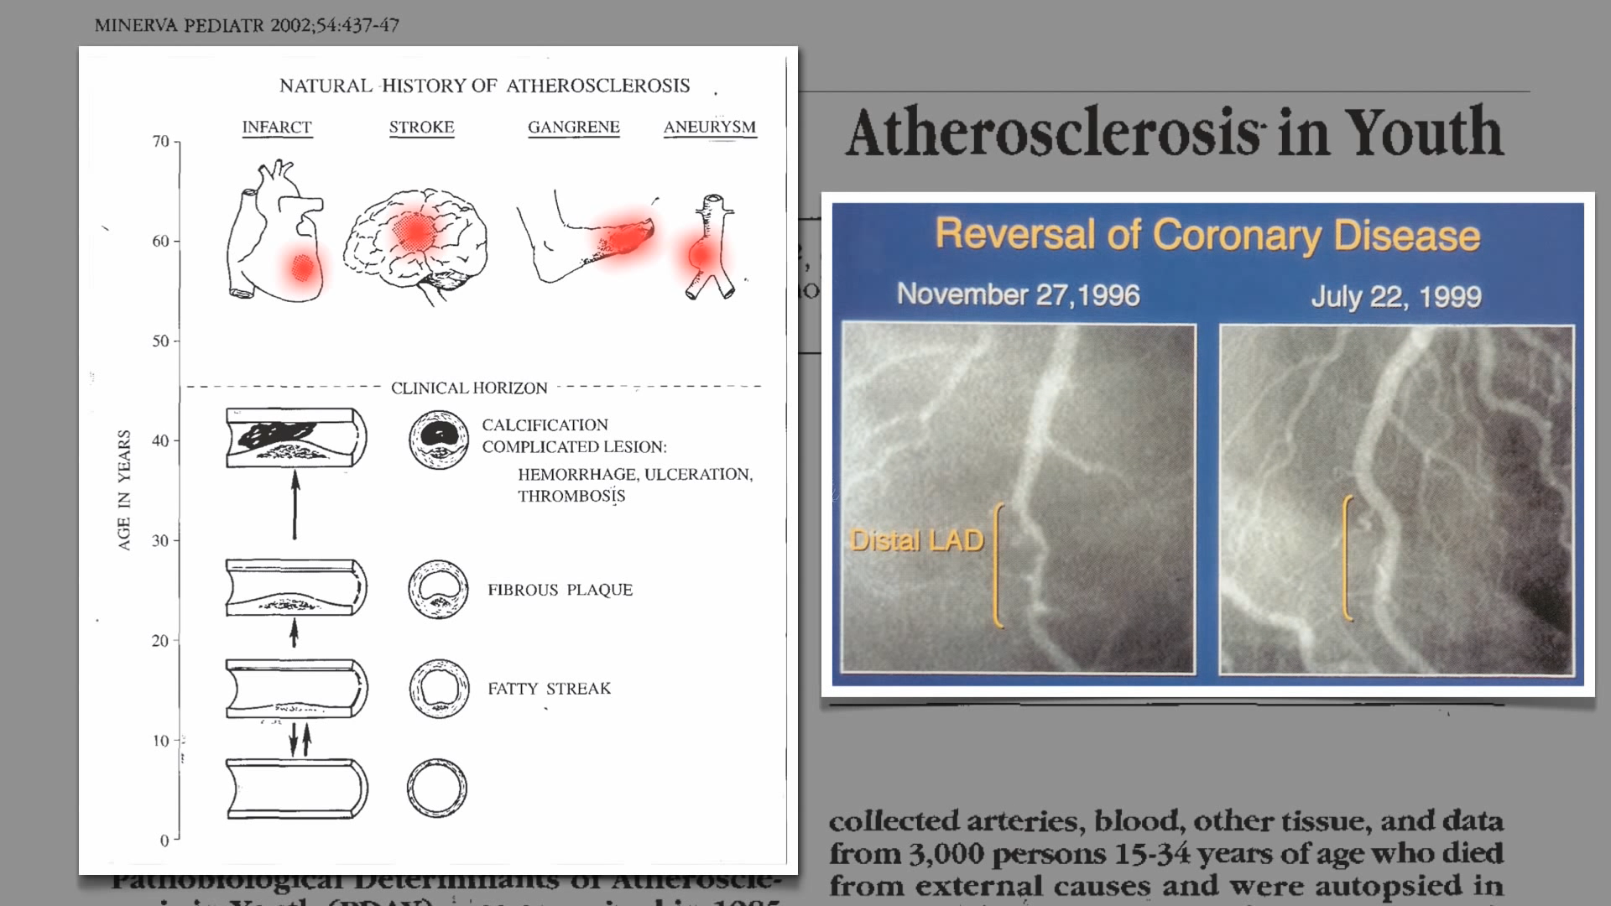

Slide 29
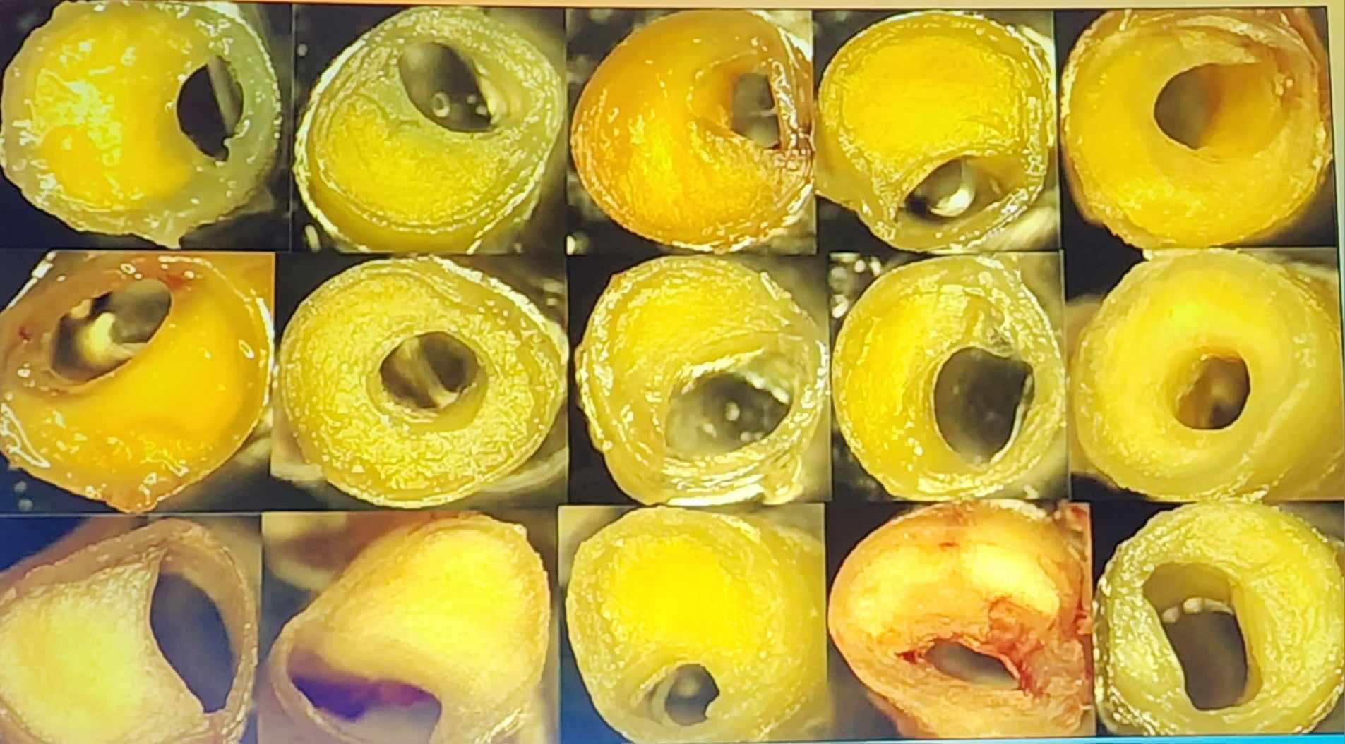

Slide 30
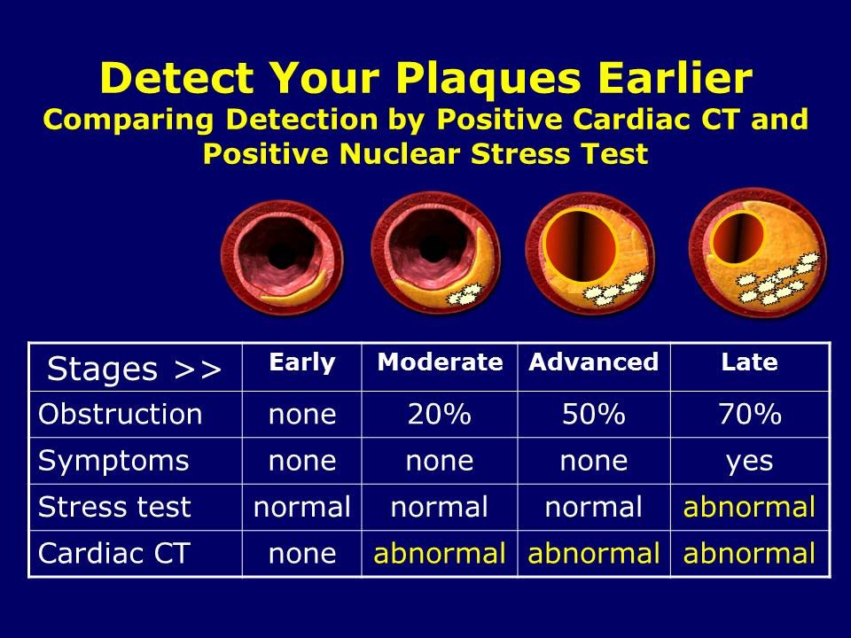
Birth
20 yo
45 yo
60 yo

Slide 31
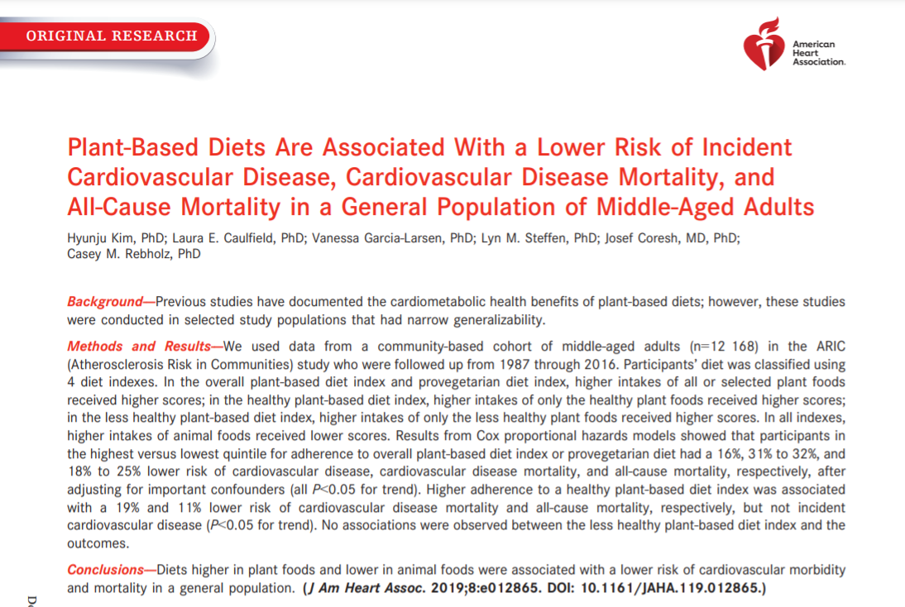

Slide 32
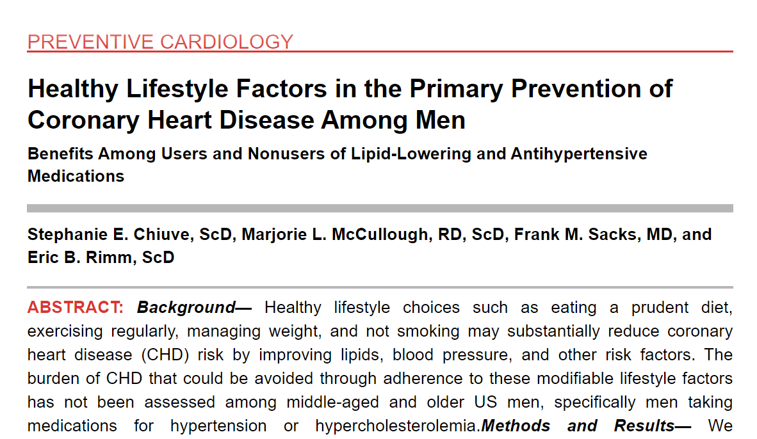
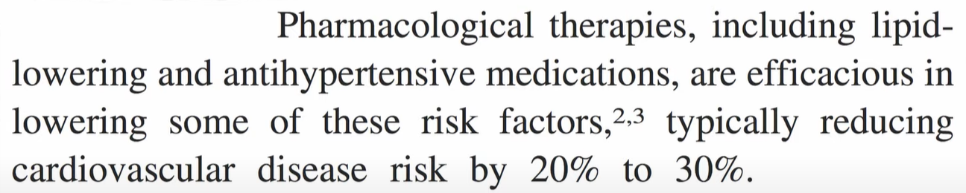

Slide 33
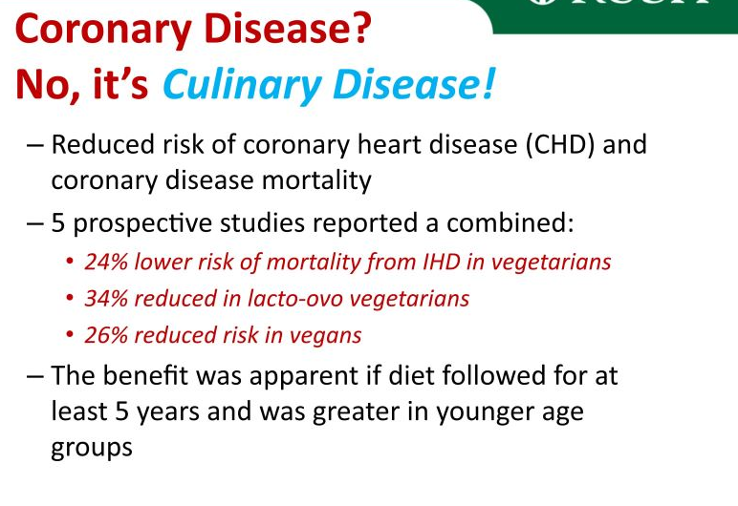

Slide 34
SESSION 5 – Activity

Slide 35
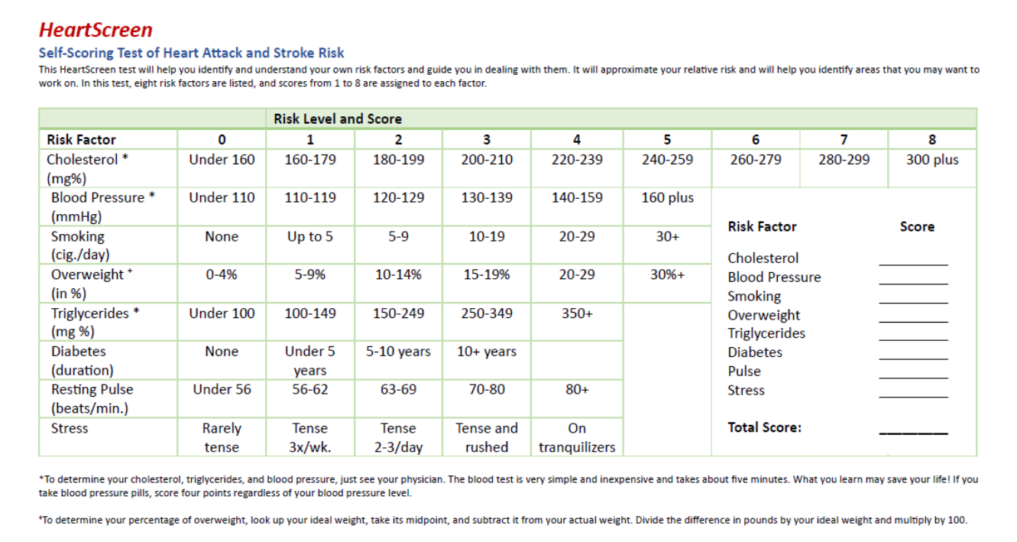

Slide 36


Slide 37

THANK YOU

